Slide 1

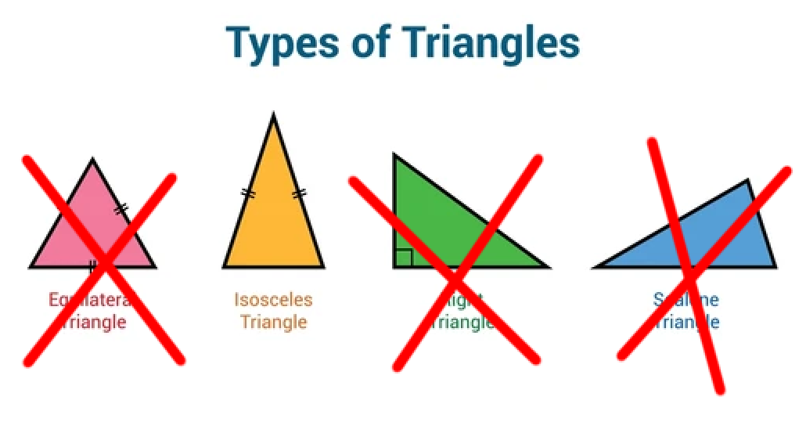
CSI3105:
Software Testing
Module 4: BVA + EP

Slide 2
Requirements Specification
The purpose of this method is to determine whether three double values entered by the user represent the sides of an isosceles triangle or not. An isosceles triangle is a triangle that has two sides of equal length. The program takes in three double values between 2 and 20 from the user and checks whether the triangle is isosceles or not.
The program should output
  "This triangle is Isosceles!" if the triangle is isosceles
  "This is an inferior triangle" if it is not isosceles.
  "Please enter valid numeric lengths between 2 and 20. " if the numbers are out of range

Slide 3
Requirements Specification
The purpose of this method is to determine whether three double values entered by the user represent the sides of an isosceles triangle or not. An isosceles triangle is a triangle that has two sides of equal length. The program takes in three double values between 2 and 20 from the user and checks whether the triangle is isosceles or not.
The program should output
  "This triangle is Isosceles!" if the triangle is isosceles
  "This is an inferior triangle" if it is not isosceles.
  "Please enter valid numeric lengths between 2 and 20. " if the numbers are out of range

Slide 4
BVA
The purpose of this method is to determine whether three double values entered by the user represent the sides of an isosceles triangle or not. An isosceles triangle is a triangle that has two sides of equal length. The program takes in three double values between 2 and 20 from the user and checks whether the triangle is isosceles or not.
The program should output
  "This triangle is Isosceles!" if the triangle is isosceles
  "This is an inferior triangle" if it is not isosceles.
  "Please enter valid numeric lengths between 2 and 20. " if the numbers are out of range
Identify inputs
  Three doubles
  Side 1, Side 2, Side 2
Identify boundaries
  2-20

Slide 5
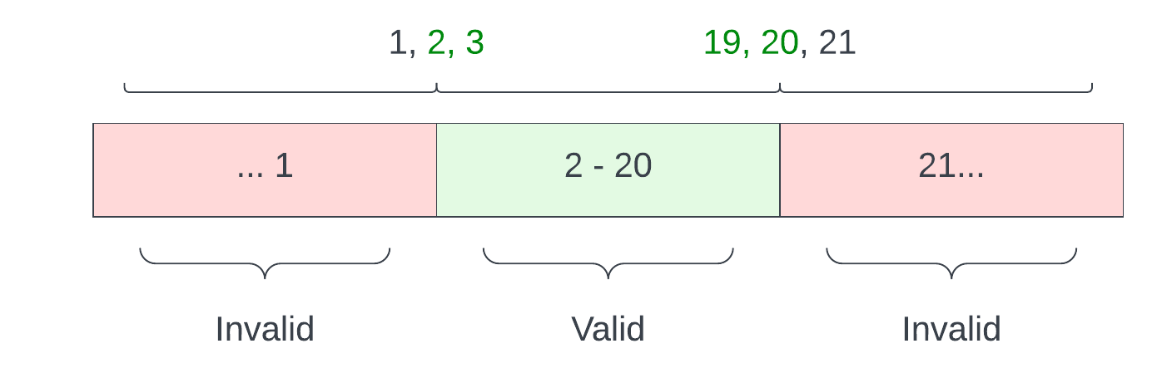
BVA
Identify inputs
  Three doubles
  Side 1, Side 2, Side 2
Identify boundaries
  2-20
Side 1:
Side 2:
Side 3:

Slide 6
BVA
Side 1:
Side 1 (hold side 2 and 3 constant)
  Lower boundary
    1, 10, 10
    2, 10, 10
    3, 10, 10
Side 1 (hold side 2 and 3 constant)
  Upper boundary
    19, 10, 10
    20, 10, 10
    21, 10, 10
Side 2:
Side 3:

Slide 7
BVA
Side 1:
Side 2 (hold side 1 and 3 constant)
  Lower boundary
    10, 1, 10
    10, 2, 10
    10, 3, 10
Side 2 (hold side 1 and 3 constant)
  Upper boundary
    10, 19, 10
    10, 20, 10
    10, 21, 10
Side 2:
Side 3:

Slide 8
BVA
Side 1:
Side 3 (hold side 1 and 2 constant)
  Lower boundary
    10, 10, 1
    10,10, 2
    10, 10, 3
Side 3 (hold side 1 and 2 constant)
  Upper boundary
    10, 10, 19
    10, 10, 20
    10, 10, 21
Side 2:
Side 3:

Slide 9
BVA
Name | Side 1 | Side 2 | Side 3 | Expected
bva_1 | 1 | 10 | 10 | Please enter valid numeric lengths between 2 and 20.
bva_2 | 2 | 10 | 10 | This triangle is Isosceles!
bva_3 | 3 | 10 | 10 | This triangle is Isosceles!"
bva_4 | 19 | 10 | 10 | This triangle is Isosceles!"
bva_5 | 20 | 10 | 10 | This triangle is Isosceles!"
bva_6 | 21 | 10 | 10 | Please enter valid numeric lengths between 2 and 20
bva_7 | 10 | 1 | 10 | Please enter valid numeric lengths between 2 and 20
bva_8 | 10 | 2 | 10 | This triangle is Isosceles!"
bva_9 | 10 | 3 | 10 | This triangle is Isosceles!"
bva_10 | 10 | 19 | 10 | This triangle is Isosceles!"
bva_11 | 10 | 20 | 10 | This triangle is Isosceles!"
bva_12 | 10 | 21 | 10 | Please enter valid numeric lengths between 2 and 20
bva_13 | 10 | 10 | 1 | Please enter valid numeric lengths between 2 and 20
bva_14 | 10 | 10 | 2 | This triangle is Isosceles!"
bva_15 | 10 | 10 | 3 | This triangle is Isosceles!"
bva_16 | 10 | 10 | 19 | This triangle is Isosceles!"
bva_17 | 10 | 10 | 20 | This triangle is Isosceles!"
bva_18 | 10 | 10 | 21 | Please enter valid numeric lengths between 2 and 20
Side 1:
Side 2:
Side 3:

Slide 10
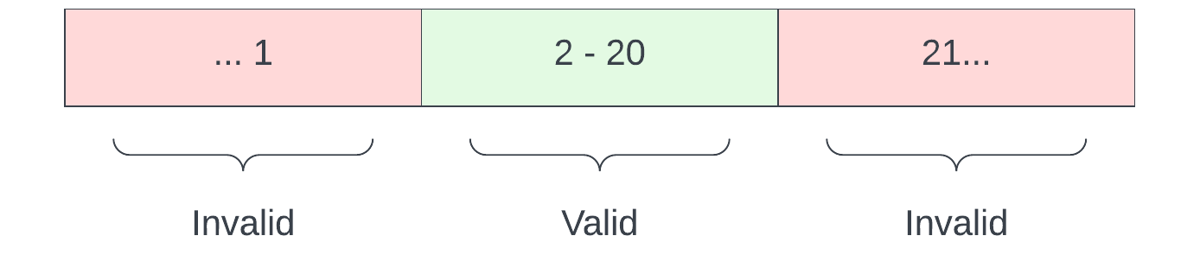
EQ
Side 1:
Valid
EQ1- Side 1 between 2-20
EQ2- Side 2 between 2-20
EQ3- Side 3 between 2-20
Invalid
EQ4- Side 1 above 20
EQ5- Side 1 under 2
EQ6- Side 2 above 20
EQ7- Side 2 under 2
EQ8- Side 3 above 20
EQ9- Side 3 under 2
Side 2:
Side 3:

Slide 11
EQ
Valid
EQ1- Side 1 between 2-20
EQ2- Side 2 between 2-20
EQ3- Side 3 between 2-20
Invalid
EQ4- Side 1 above 20
EQ5- Side 1 under 2
EQ6- Side 2 above 20
EQ7- Side 2 under 2
EQ8- Side 3 above 20
EQ9- Side 3 under 2
Weak robust (valid and invalid)
Tc 1 (covers all the valid): eq1, eq2, eq3
Tc 2 : eq4, eq2, eq3
Tc 3 : eq5, eq2, eq3
Tc 2 : eq1, eq6, eq3
Tc 3 : eq1, eq7, eq3
Tc 2 : eq1, eq2, eq8
Tc 3 : eq1, eq2, eq9
------------------------------------------------------
Tc 1 (covers all the valid): eq1, eq2, eq3
Tc1 = 10, 10, 19 -> (this is an iso triangle)

